Slide 1
The Young People Dataset
2013 Slovakian Survey on preferences and interests of young people
All participants aged between 15 and 30
Contains 1010 rows and 150 columns (139 integer & 11 categorical)
The data can be split into groups: (1) Music preferences, (2) Movie preferences, (3) Hobbies & interests, (4) Phobias, (5) Health habits, (6) Personality/Views, (7) Spending habits, and (8) Demographics
We were only interested in Music preferences, Movie preferences, and Demographics

Slide 2
Questions
Are there differences in music preferences between left handed people and right handed people?
Are there any difference in movie preference between men and women?

Slide 3
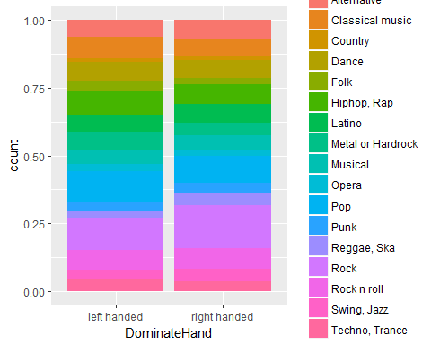
Question 1: Are there differences in music preferences between left handed people and right handed people?
1a: Genre Preference comparison for Dominate Hand
a larger number of left-handers preferred Pop over right-handers
a larger number of right-handers preferred Rock over left-handers
Overall, there is not much of a discrepensy between dominate hand and preferred music

Slide 4
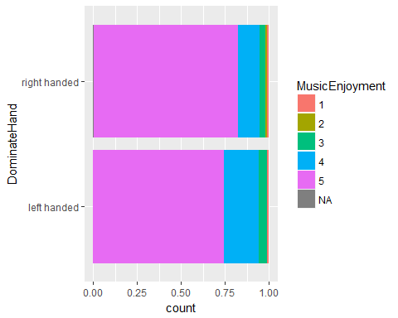
Question 1: Are there differences in music preferences between left handed people and right handed people?
1b: Dominate hand and general score of music enjoyment
There is not much of a difference between music preferences of left handed and right handed people
However, in this dataset right handed people are the majority of the dataset

Slide 5
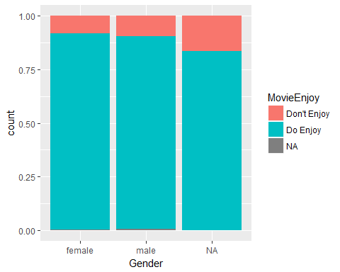
Question 2: Are there any difference in movie preference between men and women?
2a: Movie Enjoyment by Gender
Male and Female preference are very similar
Women are slightly more likely to enjoy watching movies in general

Slide 6
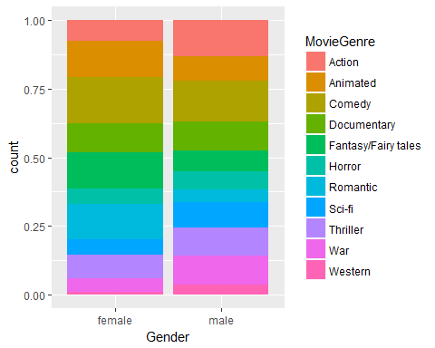
Question 2: Are there any difference in movie preference between men and women?
2b: Genre Preference by Gender
Female's preference are focused more on comedy, fantasy and romantic
Male's preference are focused more on War, Sci-fi, and Action

Slide 7
Analysis Summary
Neither dominate hand nor gender have a strong influence on general media preference.
Righthanders were more inclined to rock and left handers were more inclined to pop, but the difference may not be significant
Men were more inclined to like action and war and women were more inclined to like romance and fantasy. However, tests were not conducted to see if the difference was significant

Slide 8
Limitations and Future Analysis
Analysis was limited by Genres of Music not lining up to particular genres of Movies, and a rating from 1 to 5 not giving a very clear spread.
In the future, it would be useful to analyze if Movie Score and Music Score have any correlation.

